Slide 1
Capstone Project-3
Credit Card Default Prediction Individual Member Ishwarya

Slide 2
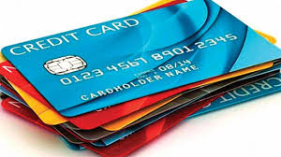
Content
Introduction
Problem Statement
Data Summary
Exploratory Data Analysis
Modelling overview
Feature Importances
Challenges
Conclusion

Slide 3

Introduction
In today’s world credit cards have become a lifeline to a lot of people so banks provide us with credit cards.
A Credit Card is a type of payment card in which charges are made against a line of credit instead of the account holder’s cash deposit. When someone uses a credit card to make purchase, that person’s account accrues a balance that must be paid off each month.
Now we know the most common issue there is in providing these kind of deals are people not being able to pay the bills. These people are what we call “defaulters”.

Slide 4
Problem Statement
Predicting whether a customer will default on his/her credit card

Slide 5
Data Summary
X1 - Amount of credit(includes individual as well as family credit)
X2 - Gender
X3 - Education
X4 - Marital Status
X5 - Age
X6 to X11 - History of past payments from April to September
X12 to X17 - Amount of bill statement from April to September
X18 to X23 - Amount of previous payment from April to September

Slide 6
Data Analysis Steps
Import Libraries: In this part, we had imported require libraries like numpy,pandas, matplotlib,seaborn, to perform Exploratory Data Analysis and For prediction we import sklearn library for credit card fraud detection
Descriptive Statistics: In this part, we start by looking at descriptive statistic parameters for the dataset. We will use describe() this tell about
unique values and standard deviation,mean, median, mode etc
Missing Value Imputation: We will now check for missing values in our dataset. In case there are any missing entries, we will impute them with appropriate values
Graphical Representation: We will start with Univariate Analysis. and end with bivariate analysis during this i draw pie chart, bar chart, count plot etc

Slide 7
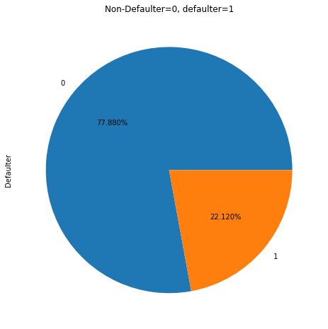
Exploratory Data Analysis
Defaulters:
Non-defaulter were 23364, Defaulter
were 6636
The above pie charts said
Non-defaulters 77.88% ,and defaulter
were 22.12%

Slide 8
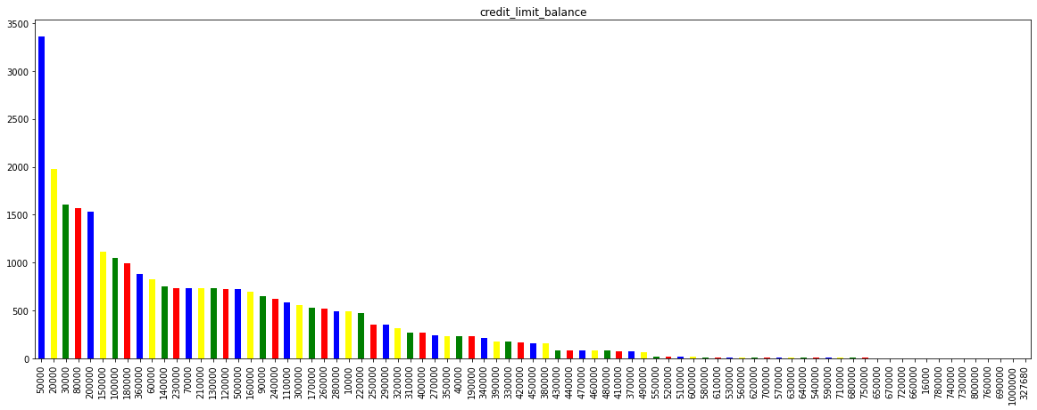
Credit Limit Balance Analysis
Most of people available credit balance is 50,000 to 3365 members.
Maximum available credit balance limit is 1,00,000
Minimum available credit balance limit is 10,000

Slide 9
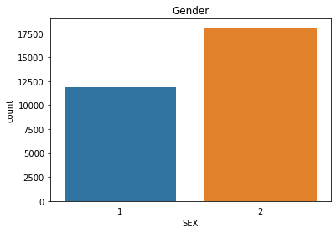
Gender Analysis
Male are 11,888
represented
as 1 and female are 18,112
represented as 2

Slide 10
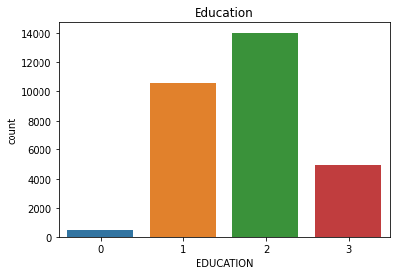
Education Analysis
Graduate school by
10,585 people
University by 14,030 people
Graduate school by
4917 people
Other studying by 468 people

Slide 11
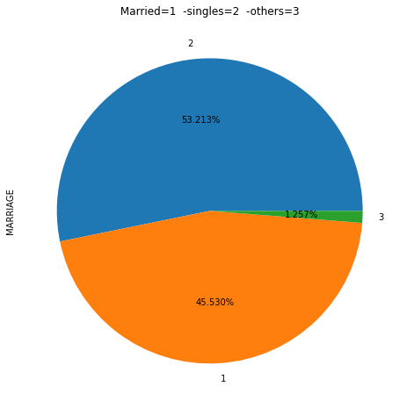
Marital Status Analysis
Married persons are 13,659
represented as 1
Single persons are 15,964
represented as 2
Others are 377 represented as 3

Slide 12
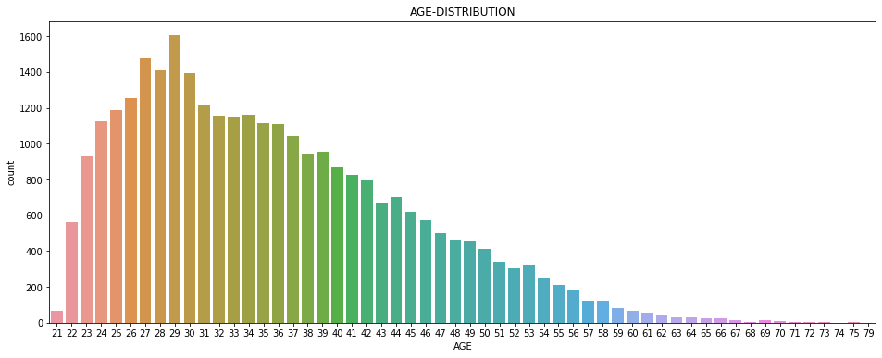
Age Distribution
Most credit cardholders AGE was 25-45 and above age 60 people are used rarely credit cards
Most of 29th age people used huge credit cards that number is 1605 and second place was 27th age people it's number 1477

Slide 13
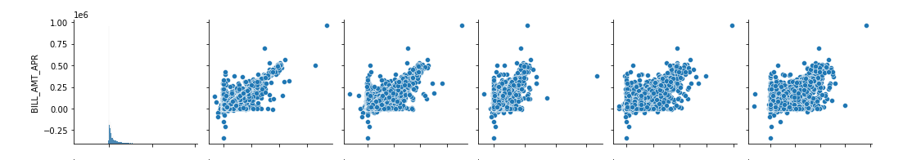
Bill Amount Distribution
This pairplot shows that distribution of bill amount statements for April explicitly for defaulters and non-defaulters

Slide 14
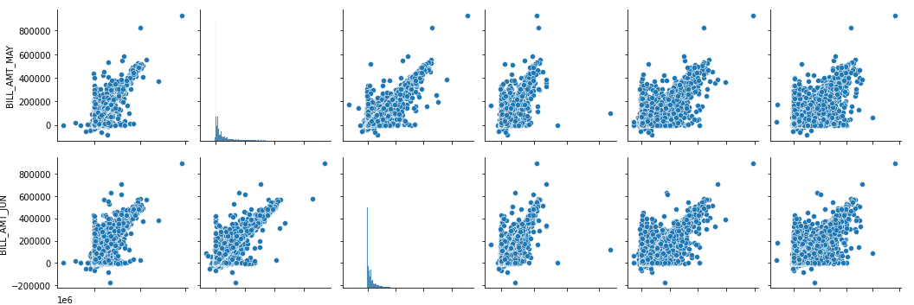
Bill Amount Distribution
This pairplot shows that distribution of bill amount statements for May and June month explicitly for defaulters and non-defaulters.

Slide 15
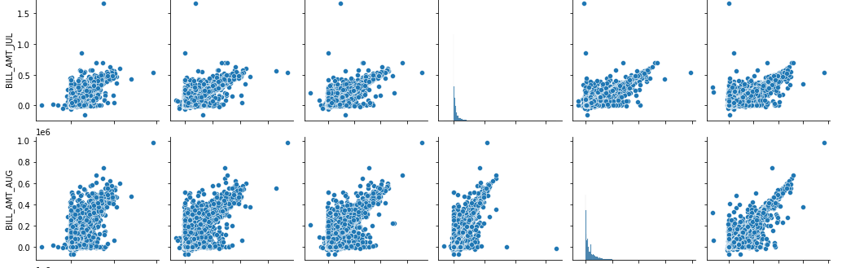
Bill Amount Distribution
This pairplot shows that distribution of bill amount statements for July and August month explicitly for defaulters and non-defaulters.

Slide 16
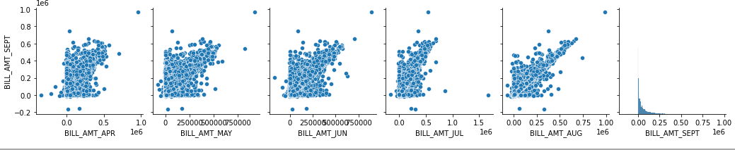
Bill Amount Distribution
This pairplot shows that distribution of bill amount statements for each month explicitly for defaulters and non-defaulters.

Slide 17
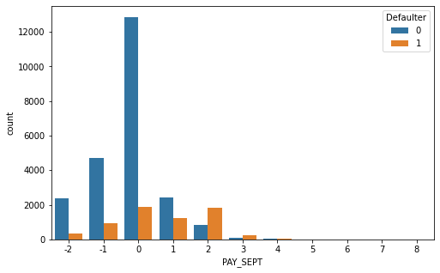
Previous Payment Distribution (September Month)
In the payment of september month
single rupee not receive from
Non-defaulters were
2394 persons, and from defaulters were
365 persons
Full amount received from
Non-defaulters
were 4732 persons and defaulters
were 954 persons
Minimum amount received from Non-
defaulters were 12,849 persons and Defaulters

Slide 18
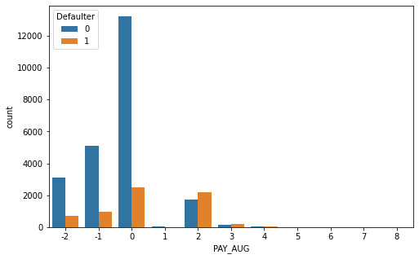
August Payment Distribution
In the payment of august month
single rupee not receive from Non-defaulters
were 3,091 persons, and from
defaulters were 691 persons
Full amount received from
Non-defaulters were 5,084 persons and
defaulters were 966 persons
Minimum amount received rom
Non- defaulters were 13,227 persons and
Defaulters were 2,503 persons

Slide 19
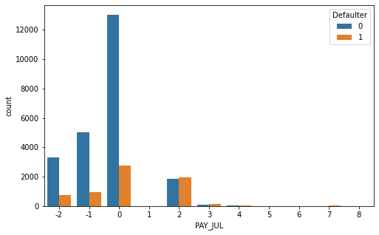
July Payment Distribution
In the payment of July month
single rupee not receive from
Non defaulters were 3328 persons,
and from defaulters were 757 persons
Full amount received from
Non-defaulters were 5012 persons and
defaulters were 926 persons
Minimum amount received from
Non- defaulters were 13,013 persons and
Defaulters were 2,751 persons

Slide 20
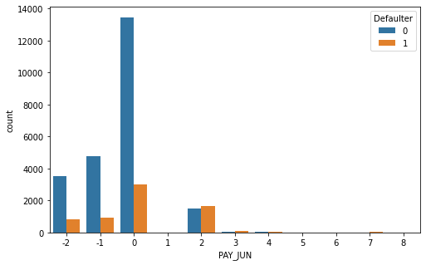
June Payment Distribution
In the payment of June month single rupee
not receive from Non-defaulters were 3,511 persons,
and from defaulters were 837 persons
Full amount received from Non-defaulters
were 4,783 persons and defaulters were 904 persons
Minimum amount received from
Non- defaulters were 13,439 persons
and Defaulters were 3,016 persons

Slide 21
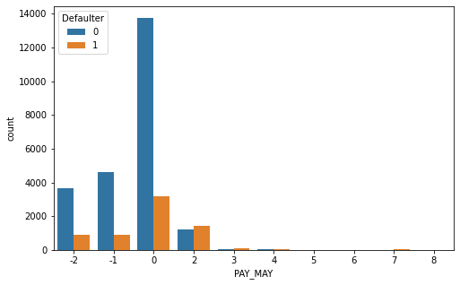
May Payment Distribution
In the payment of May month
single rupee not receivefrom
Non-defaulters were 3,651 persons, and
from defaulters were 895 persons
Full amount received from Non-defaulters
were 4,642 persons and
defaulters were 897 persons
Minimum amount received from Non- defaulters
were 13,752 persons and
Defaulters were 3,195 persons

Slide 22
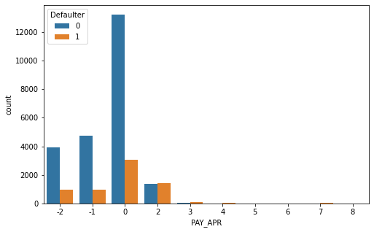
April Payment Distribution
In the payment of April month
single rupee not receive from
Non-defaulters were 3,914 persons, and
from defaulters were 981 persons
Full amount received from
Non-defaulters were 4,765 persons and
defaulters
were 975 persons
Minimum amount received from
Non- defaulters were 13,217 persons and
Defaulters were 3,069 persons

Slide 23
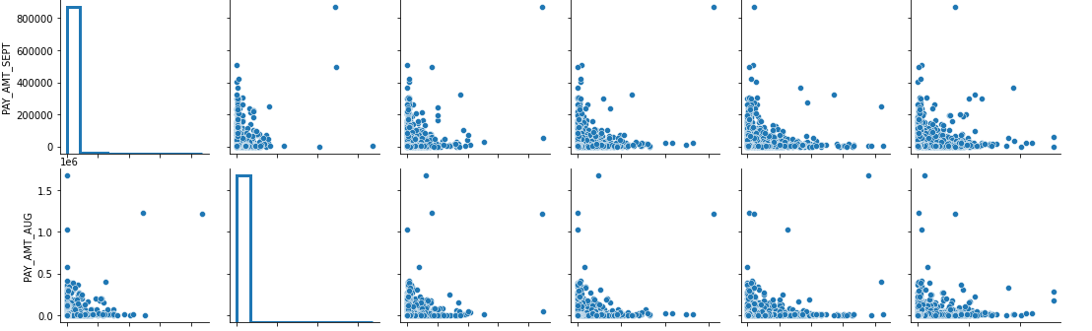
Distribution Of Previous Payment
Pairplot said that Sep and Aug month of the payment states Defaulters and Non-defaulters.

Slide 24
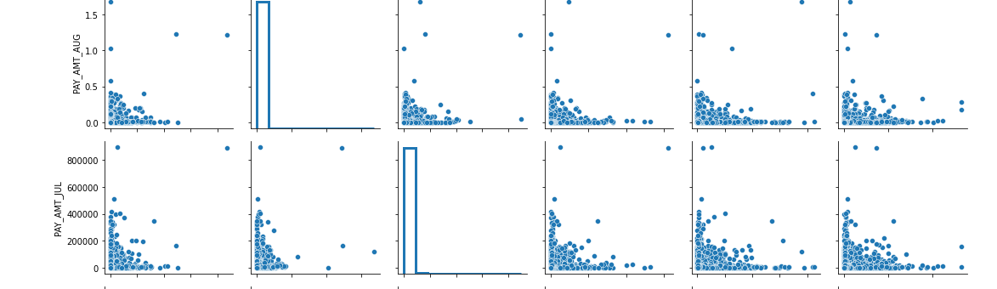
Distribution Of Previous Payment
Pairplot said that Aug and July month of the payment states Defaulters and Non-defaulters.

Slide 25
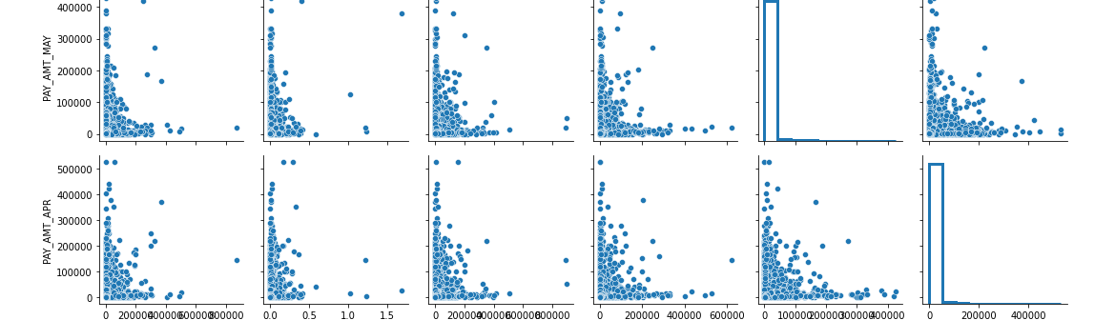
Distribution Of Previous Payment
Pairplot said that May and Apr month of the payment states Defaulters and Non-defaulters.

Slide 26
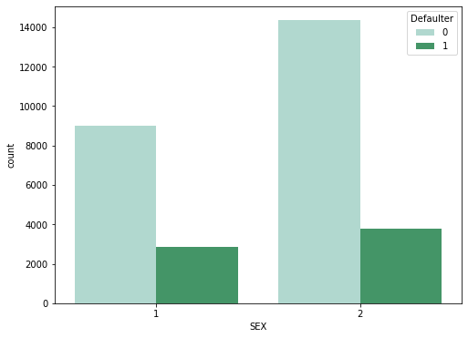
Bivariate Analysis Gender wise Defaulters
Defaulters were females, their number was 3763 and Height Non- defaulters also famales it's number 14,349

Slide 27
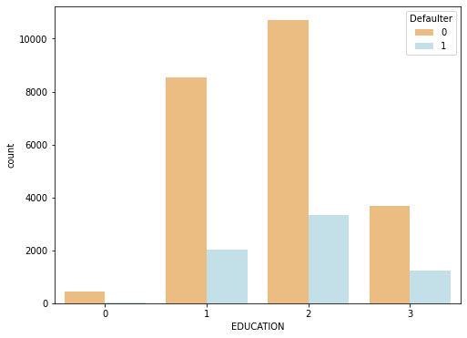
Education Wise Defaulters
Defaulters who did study in University people its number was 3,330 and after that graduate school people are defaulter their number was 2036. 1 represented as graduate school,2 represented as university,3 represented as high school,0 represented as others.

Slide 28
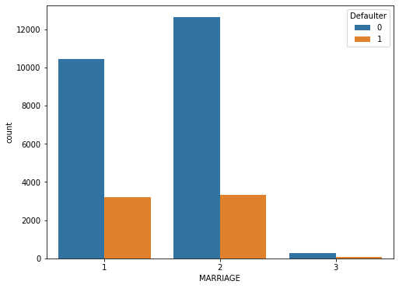
Marital Wise Defaulters
Most of the defaulters were singles their numbers was 3341 and defaulters in married people were 3206 and defaulters in others were 89.

Slide 29
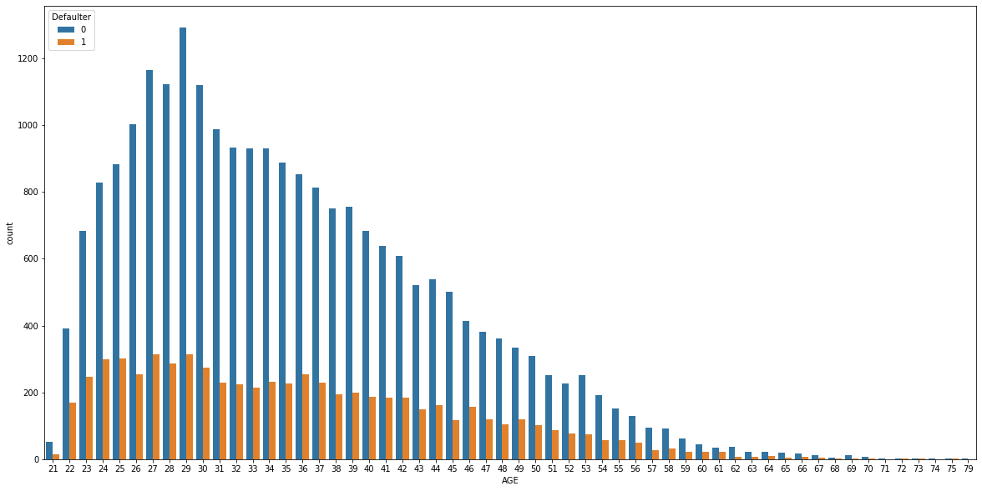
Age Wise Defaulters
Most of 27th age people defaulters least defaulters were above 60age people were defaulters.

Slide 30
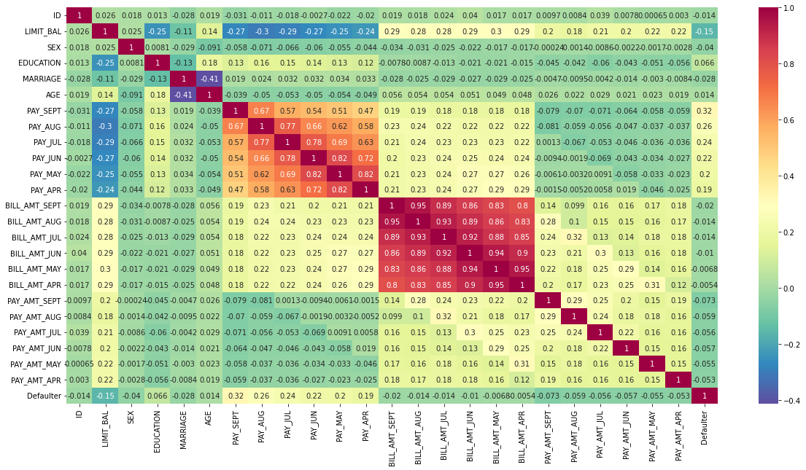
Heatmap Correlation
HH
In this heatmap we can conclude that correlation relationship between any two columns,some part
of data having highly correlated,some part of data having negative correlated and
some data have zero correlated.

Slide 31
Applying SMOTE(Synthetic Minority Oversampling Technique)
In heatmap, Highly correlated items "PAY_SEPT","BILL_AMT_SEPT","PAY_AMT_SEP removed.
After dataset is imbalanced dataset so we need to do the balance using SMOTE(Synthetic Minority Oversampling Technique)
We got,
Original dataset shape Counter({0: 18691, 1: 5309})
Resample dataset shape Counter({1: 23364, 0: 23364})
Counter({0: 23364, 1: 23364})

Slide 32
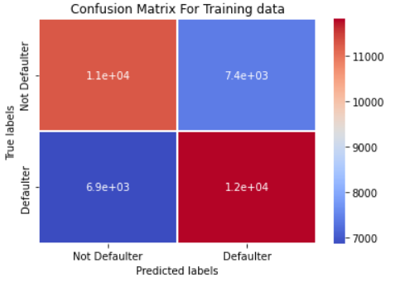
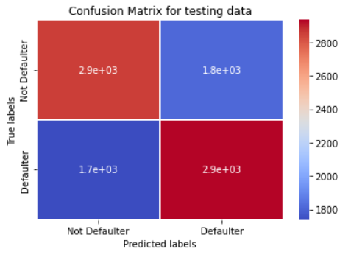
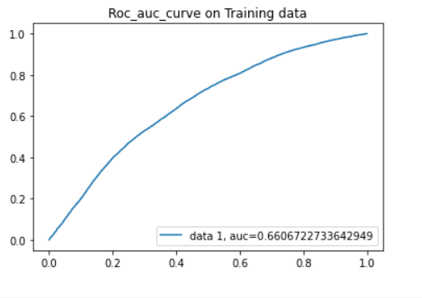
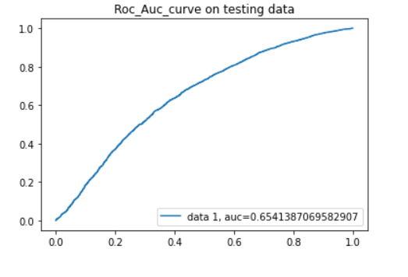
Logistic Regression
We have implemented logistic regression and we getting accuracy_score is approx 62%. and precision score approx is 62% and f1_score is 62%and roc_auc approx is 62% As we have imbalanced dataset, recall_score is approx 63% better parameter. Let's go ahead with other models and see if they can give better result

Slide 33
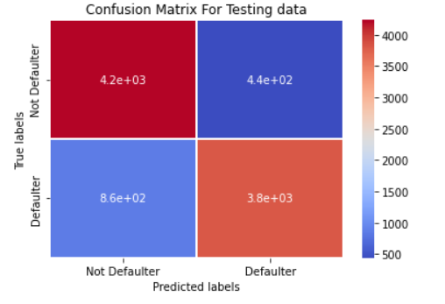
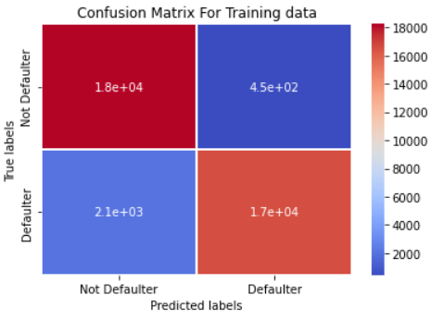
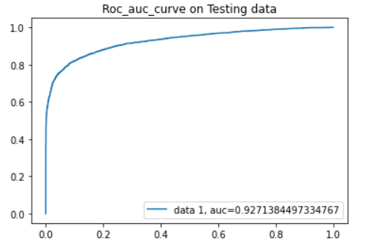
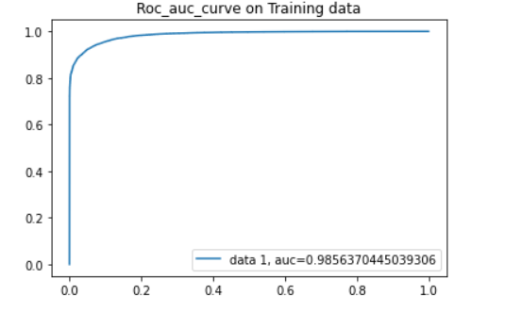
Random Forest Classifier
By implemented Random Forest and we getting accuracy_score is approx 86%. and recall_score is approx 82%,and f1_score is 85%,ROC_AUC score is 86%, precision score is 90% better parameter
i

Slide 34
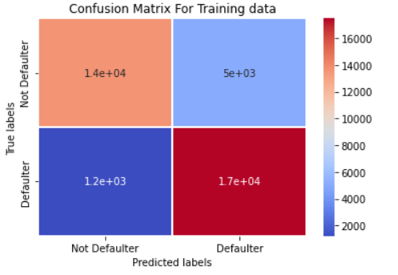
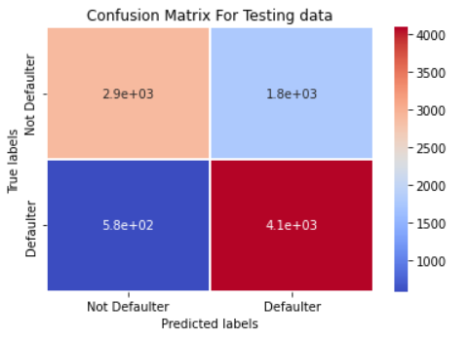
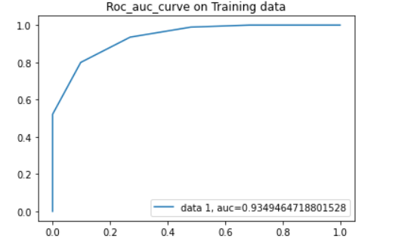
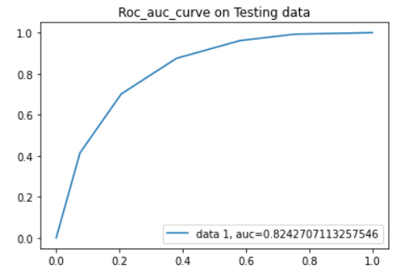
KNN Classifier
By implemented KNN and we getting accuracy_score is approx 75%. and precision score is approx 70% and f1_score is 76% and ROC_AUC score is 75% ,recall_score is approx 88% better parameter

Slide 35
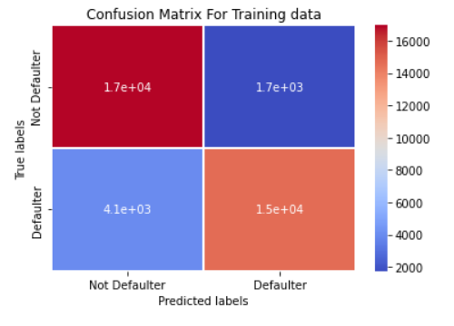
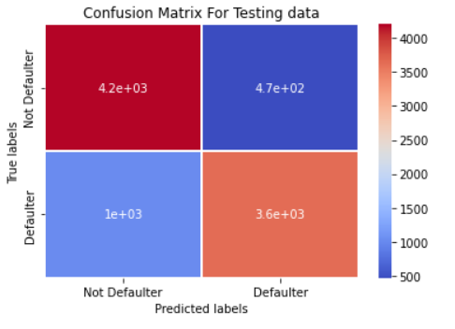
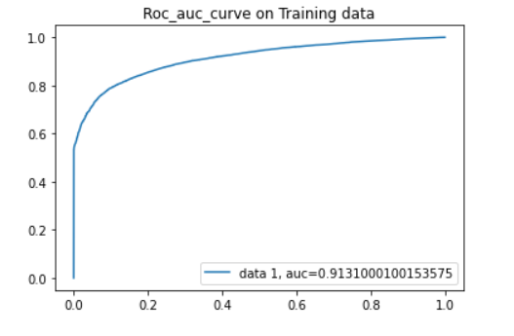
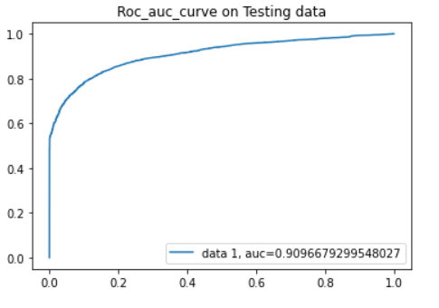
XGBoost Classifier
By implemented XGBOOST WITH GRID SEARCH CV and we getting accuracy_score is approx 84%. and recall_score is approx 78% and f1_score is 83% and ROC_AUC score is 84% ,precision score is approx 90% better parameter

Slide 36
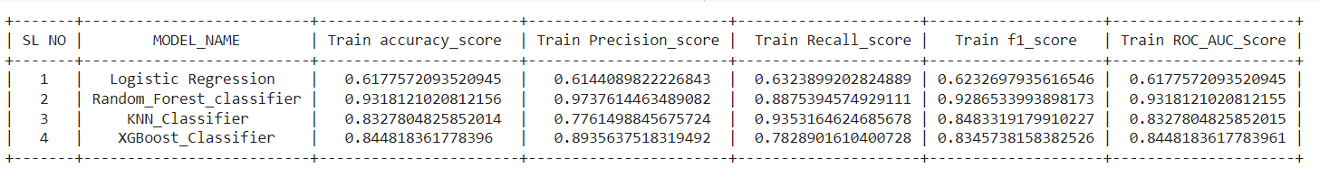
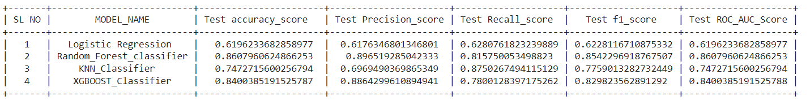
Summary For Train and Test Data
TRAIN SUMMARY
TEST SUMMARY

Slide 37
Challenges
Understanding the columns.
Feature engineering.
Getting a higher accuracy on the models.

Slide 38
Conclusion
By used different type of Classification algorithms to train our model like, Logistic Regression, Random Forest Classifier,KNN_Classifier, XGboost_Classifier. and Also we tuned the parameters of Random forest classifier and XGboost classifier ,KNN_ Out of them Random forest classifier with Grid search CV ( tuned hyperparameters gave) the best result.
Highest Precision score is approx 90%,
ROC_Auc score is approx 86%,
and Accuracy_score is approx 86%,
and It's F1_score approx is 85%,
Recall_score approx is 82%

Slide 39
Thank you
T

